Slide 1
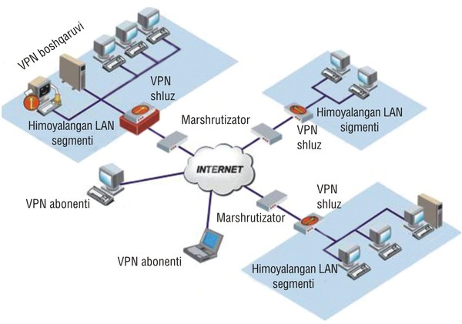
TARMOQ ADMINISTRATORLIGI 22-DARS

Slide 2

Linux operatsion tizimida Samba serverni sozlash

Slide 3
Linux operatsion tizimida Samba serverni sozlash
Ko'p hollarda Windows va Linux operatsion tizimlari bilan bir vaqtda ishlashga to'g'ri kelib qoladi. Bu ikki operatsion tizim bir-biridan keskin farq qiladi, hattoki fayl tizimlari ham xar hil. Shunday bo'lsa ham, har birining o'z o'rni bor. Linux operatsion tizimi asosan biror server yaratishda foydalanilsa, windows esa doimiy ish jarayoni uchun qulaydir.
Ma'lumot almashishga kelsak, tarmoqdagi windows operatsion tizimidan turib Linux operatsion tizimi kataloglarini bevosita ko'rib bo'lmaydi. Uning uchun xar hil protokollardan yoki dasturlardan foydalanish lozim. Bularning ichida eng soddasi linux operatsion tizimida mavjud bo'lgan Sambaserverdir.

Slide 4
Linux operatsion tizimida Samba serverni sozlash
Samba server orqali, windows operatsion tizimidan turib linux operatsion tizimi kataloglarini(oldindan ajratilgan) oddiy windows tizimidagi kabi ko'rish mumkin bo'ladi, hattoki linux tizimi kataloglarini tarmoq diski ko'rinishiga ham keltirib qo'yish mumkin.

Slide 5
Linux operatsion tizimida Samba serverni sozlash
papka yaratib olamiz mkdir sambapapka
2) yaratgan papkaga huquq beramiz chmod 777 sambapapka
3) samba serverni .conf faylini nastroyka qilib chiqamiz nano /etc/samba/smb.conf
4) ochgan .conf faylimiz oxiriga bir nechta uzgarishlar kiritamiz

Slide 6
Linux operatsion tizimida Samba serverni sozlash
[ALL] comment = bu papkaga hamaga ruhsat bor public = yes path = /sambapapka guest ok = yes writeable = yes directory mask=0777 create mask=0666 browseable = yes read only = no

Slide 7
Linux operatsion tizimida Samba serverni sozlash
[For IP address] comment = bu papkaga esa ruhsat etilgan ip address kirishi mumkin public = yes path = /sambapapka1 guest ok = yes writeable = yes #printable = no directory mask=0777 create mask=0666 browseable = yes read only = no hosts allow = 192.168.1.1(ruhsat etilishi kerak bulgan ip manzili yoziladi)
hosts deny = 192.168.1.2(ruhsati bo’lmagan bulgan ip manzili yoziladi)

Slide 8
Linux operatsion tizimida Samba serverni sozlash
[For User] comment = bu papkaga esa ruhsat etilgan foydalanuvchi kiraoladi yani foydalanadi public = yes path = /sambapapka2 guest ok = yes writeable = yes directory mask=0777 create mask=0666 browseable = yes read only = no valid users = usernomi(ruhsat etilgan foydalanuvchi nomi yoziladi)
invalid users = usernomi(ruhsat etilmagan foydalanuvchi nomi yoziladi)

Slide 9
Linux operatsion tizimida Samba serverni sozlash
5) samba serverga restart beramiz /etc/init.d/samba restart 6) windowsdan samba serverni tekshiramiz \\192.168.1.1() 7) papkaga foydalanuvchi orqali kirmoqchi bulsa avval foydalanuvchi yaratib va parol qo'yvolish kerak bo'ladi adduser sambauser smbpasswd -a sambauser /etc/init.d/samba restart 8) samba serverini qanaqa jaroyonda turganligini bilish uchun quyidagicha kamanda yoziladi /etc/init.d/samba status (statusini bilish) /etc/init.d/samba stop (sambani stop qilish) /etc/init.d/samba start (sambani ishga tushirish) /etc/init.d/samba restart (sambani uchirib yoqish)

